Slide 1
Components of Stormwater Management Systems
Prepared by Emma Melvin, PHS
Notes:
Welcome to this Green Infrastructure Maintenance Training. This presentation is one of several in the training series.
You can view the entire series sequentially, or each module independently.

Slide 2
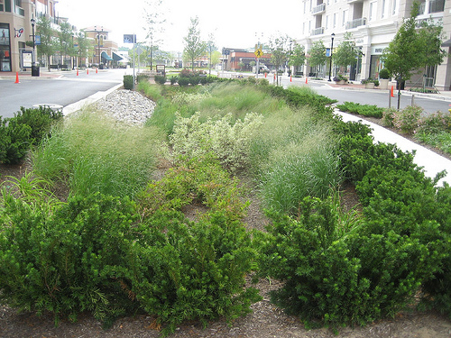
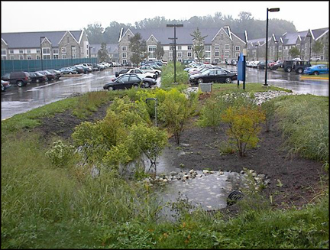
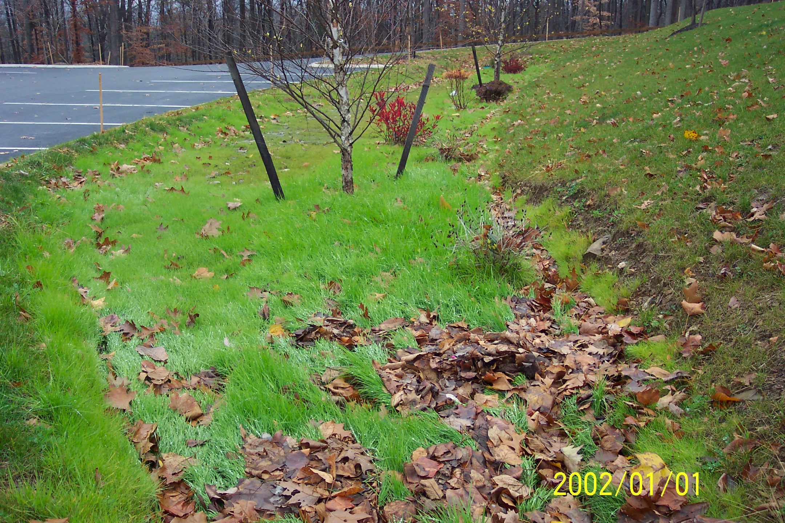
Overview
What are the components of stormwater management practices?
What are maintenance issues that can arise in the SMPs?
What basic steps should we take to maintain the systems for continued function?
Notes:
In this presentation you will learn:
What are the components of stormwater management practices?
What are maintenance issues that can arise in the SMPs?
What basic steps should we take to maintain the systems for continued function?

Slide 3
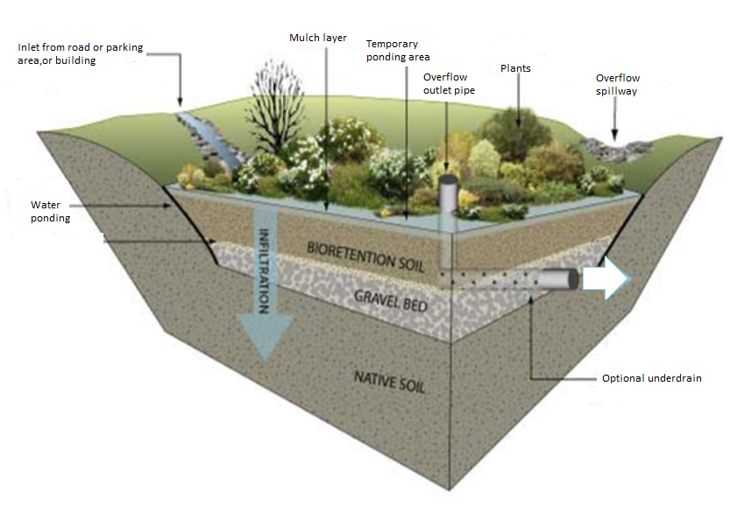
Bioretention Cross-Section
Notes:
This system, also called a rain garden, includes plants that can tolerate wet and dry soil conditions, well-draining soils, a recessed planting bed, an inlet to allow water into the system, and outlet to allow excess water out of the system.

Slide 4
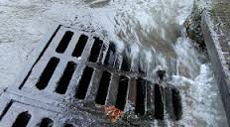
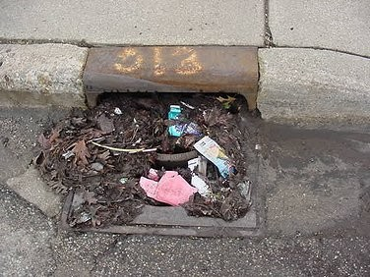
Stormwater Inlets
Stormwater Drain Inlets
Notes:
In developed areas we have historically tried to drain water off our built environment and into a conveyance system as quickly as possible. Storm drain inlets like these generally lead through the culverts or pipes of grey infrastructure systems, and then to outfalls that release the water directly to a local water body. They may also lead to retention basins, where the water is held for a period of time and then slowly released through an outfall. It is critical to keep the inlets clear from debris so that water can enter the system.

Slide 5
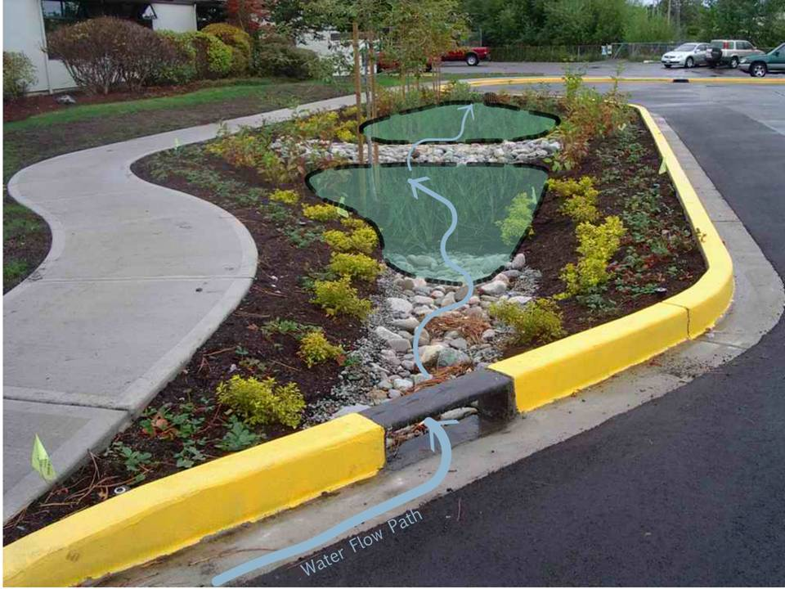
Bioretention
Cross-section
Notes:
Bioretention systems are sized to allow water to move into the system, to pond, drain and move out of system when filled to capacity. Inlets that are designed to allow water in are reinforced to reduce erosion caused by rapidly flowing water. The ponding areas can be terraced, with a check dam to slow water movement through the system, standing for no longer than 72 hours. If system has two ponding areas, different maintenance issues will be present in the two ponding areas. The first ponding area will have more sediment deposition and may have slower drainage because of this.

Slide 6
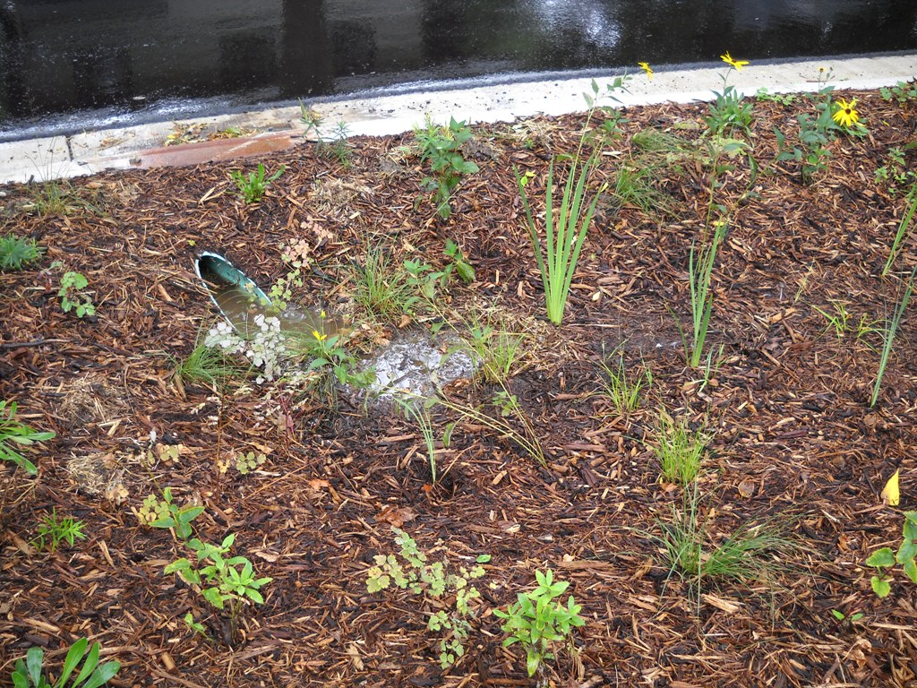
Inlets
Pipe inlet
Notes:
Inlets that may be present in a bio-retention system can include pipes…

Slide 7
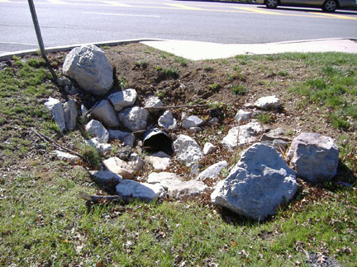
Inlets
Culvert
Notes:
….culverts under roads

Slide 8
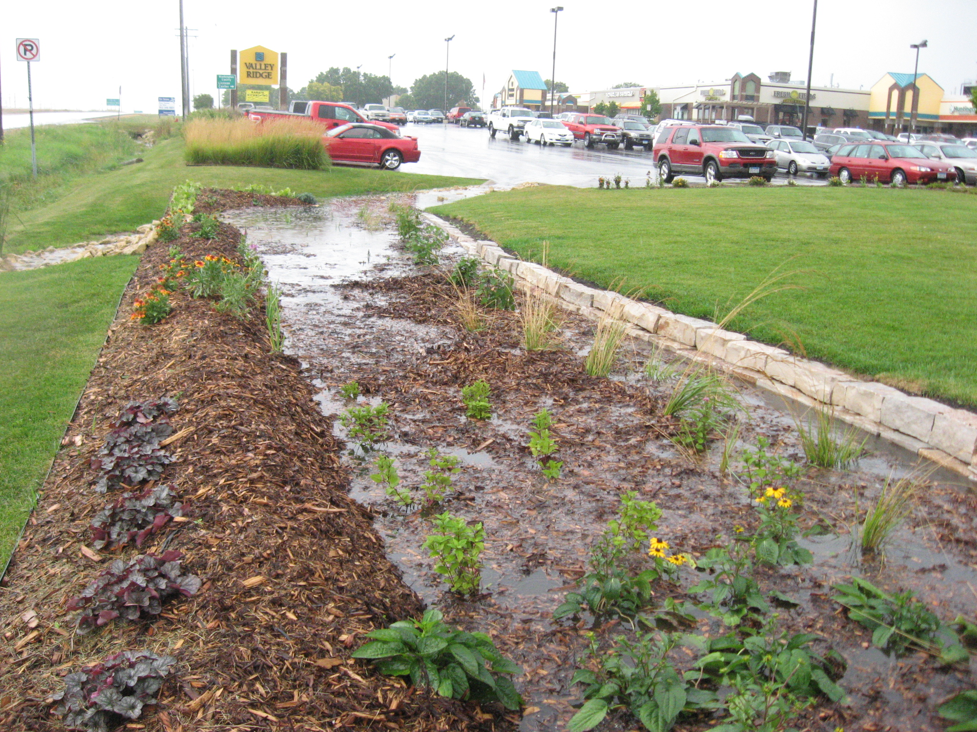
Inlets
Swale
Notes:
…Swales with various surfaces to direct and slow down water, such as mulch- lined,

Slide 9
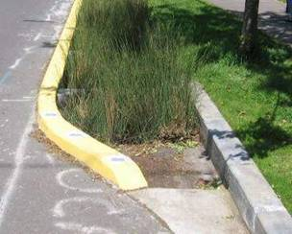
Inlets
Grass-lined swale
Notes:
….grass lined

Slide 10
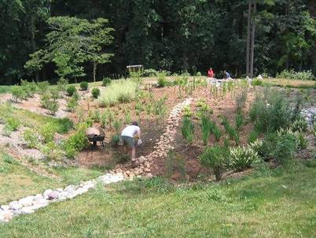
Inlets
Rock-lined swale
Notes:
…Or rock lined swales.

Slide 11
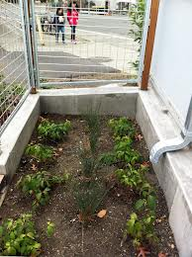
Planting Bed or Ponding Area
Notes:
A properly-sized ponding area holds water for up to 72 hours before the water is infiltrated. Water can enter the planting bed in many ways and each system has different maintenance issues. Following are examples of different planting beds. Some are confined….

Slide 12
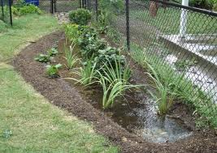
Planting Bed or Ponding Area
Notes:
… and others are open. Their function depends on a healthy grouping of appropriate plants. If too much sediment is allowed to settle in the ponding area, the plants may be smothered.

Slide 13
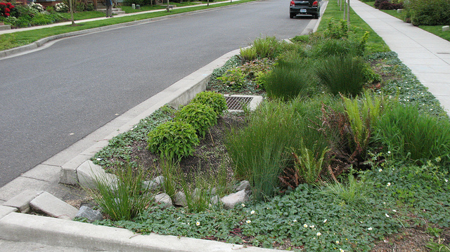
Planting Bed or Ponding Area
Notes:
Water can enter directly from a street through a curb cut…

Slide 14
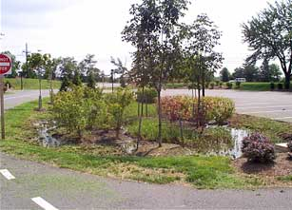
Planting Bed or Ponding Area
Notes:
… or as runoff from a parking lot.

Slide 15
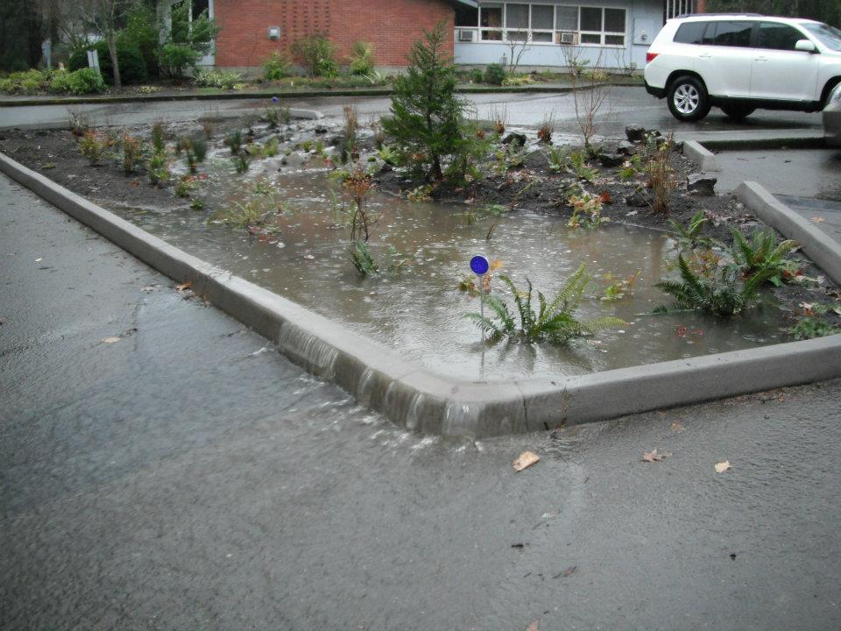
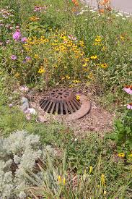
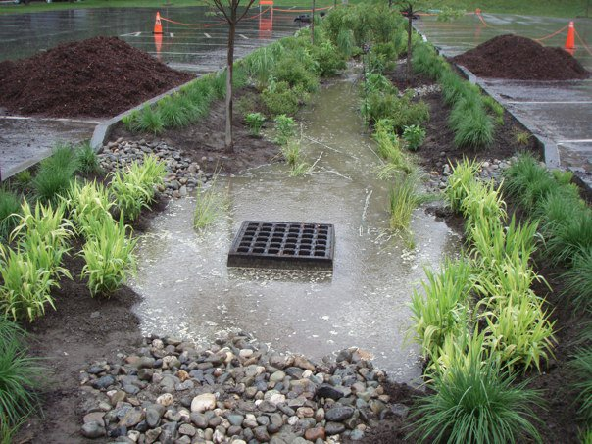
Overflow or Outlet
Notes:
Bio-retention systems are designed to hold and retain a certain volume of water. Excess water will be directed out of the system through the outlet which could take several forms. The outlet of the system could be a dome riser grate located inside the planting bed. If the outlets become clogged, the stormwater may flow out of the system and become surface runoff again.

Slide 16
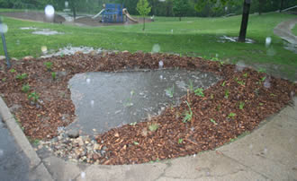
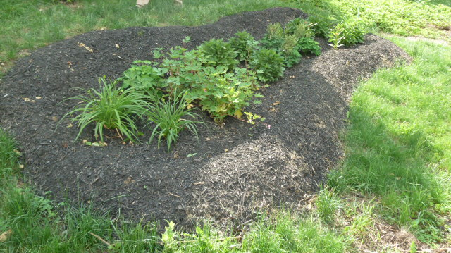
Overflow or Outlet
Notes:
There could also be recessed sections on the edges of the planting bed that will allow for overflow during larger rain events. The overflow would then enter the traditional stormwater system.

Slide 17
You Have Learned:
The components of stormwater management practices
Maintenance issues that can arise in the SMPs
Basic steps we should take to maintain the systems for continued function
Notes:
We hope you now have an understanding of what makes up a stormwater management system and how important it is to keep them properly maintained.
In this presentation you have learned:
The components of stormwater management practices
Maintenance issues that can arise in the SMPs
Basic steps we should take to maintain the systems for continued function

Slide 18
Notes:
This concludes this presentation on riparian buffer management for green infrastructure. Thank you to our funder – the US Environmental Protection Agency Region III, and partners AKRF, Inc. and GreenTreks Network, which helped produce this series.

